Slide 1
Application Architecture
In Software Engineering
1
Notes:
Assalamu alaikum Everyone, At first We are very thankful to our honorable Dr. Md Zulfikkar Mahmud Sir For Giving Us the opportunity here. Our Presentation Topic is Application Architecture in Software Engineering. So Lets Start Our Discussion.

Slide 2

Executive summary
Our presentation dives into the pivotal framework governing on application architecture. The architecture serves as the backbone, orchestrating seamless functionality, scalability, and resilience.
We will discuss about , uses, benefits , types, disadvantages and so on about application architecture.
2
Notes:
So,today we are going to discuss about ,benefits , types , challenges and so on on the topic of Application Architecture.

Slide 3
Table of contents
01
02
03
04
05
06
Definition
Uses
Benefits
Categories
Challenges and risks
Team Preference, end.
3
Notes:
Here We are deviding our presentation in some parts with different criteria. Have definition uses benefits categories challenges

Slide 4
01
What is Application Architecture?
4
Notes:
So before the Definition , Lets think When we listen the word Architecture , What comes to our mind first? Obviously, this reminds us something like Blueprint, structures on which the overall thing depends.

Slide 5

Application Architecture
The blueprint to communicate the following design decisions:
Defines the methods and patterns
The degree to which the information system will be centralized or distributed.
The distribution of stored data.
The implementation technology for software developed in-house.
The integration of commercial off-the-shelf software.
The technology to be used to implement the user interface.
The technology to be used to interface with other systems.
provides the direction and best practices to build your application with the right features and structure.
5
Notes:
Application architecture defines the methods and patterns you can follow to design and build your application. It provides the direction and best practices to build your application with the right features and structure. The behavior of your application is determined by the architecture it is built upon.
Architecture is the starting point in the process of developing an application and it shows how different components of your application are to be arranged. It also provides details on how different components will interact and deliver functionality.

Slide 6
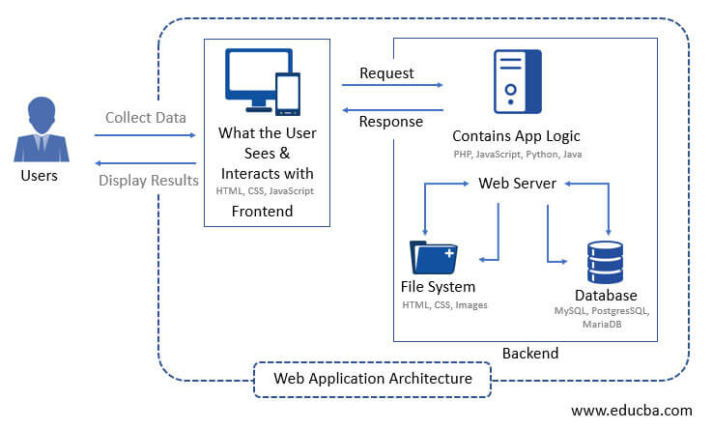
6

Slide 7

02
Uses of Application Architecture
7

Slide 8
Uses of Application Architecture
It provides a whole picture of your application to ensure a smooth implementation.
It can help to reduce costs by avoiding redundancies.
You can build your app precisely with a consistent roadmap.
It helps to make the right choices for functionalities and app structure.
You can build a well-structured application by reducing complexities.
8
Notes:
What is the Use of Application Architecture?
To answer this question, just imagine if you want to reach a destination you haven’t been to before, how will you do it? It’s obvious that you can use a mapping service like Google Maps to find the location and reach there by following the directions and instructions. Similarly, architecture provides you with a pattern and guidelines to implement your application to bring it into reality. The other benefits of software application architecture include:
It provides a whole picture of your application to ensure a smooth implementation.
It can help to reduce costs by avoiding redundancies.
You can build your app precisely with a consistent roadmap.
It helps to make the right choices for functionalities and app structure.
You can build a well-structured application by reducing complexities.

Slide 9

03
Benefits of Application Architecture
9

Slide 10
Benefits
Scalability
Maintainability
Flexibility and Agility
Performance
Security:
Cost-Effectiveness
Documentation and Understanding:
10

Slide 11
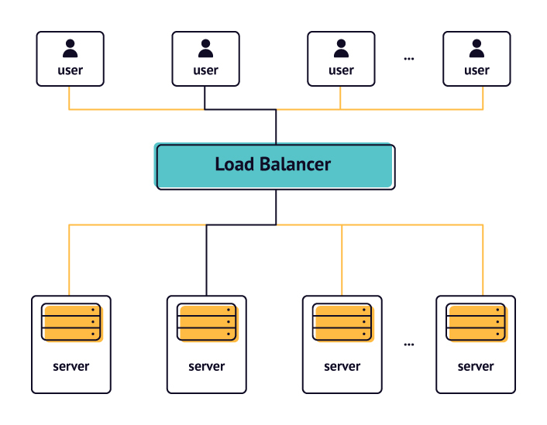
Scalability:
ensures that the system can handle increased loads.
11
Notes:
A well-designed architecture allows for the easy scaling of applications, whether vertically (upgrading hardware) or horizontally (adding more instances). This ensures that the system can handle increased loads.

Slide 12
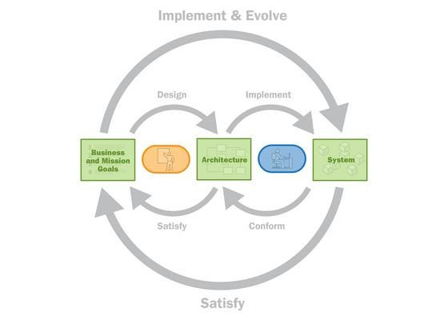
Maintainability:
This allows for better code readability, reusability, and easier debugging..
12
Notes:
A good architecture separates concerns, making it easier to maintain and update different parts of the application without impacting the whole system. This allows for better code readability, reusability, and easier debugging.

Slide 13
Benefits in Software Engineering
Flexibility and Agility
A modular architecture enables easier modifications and additions to the system. It allows teams to adapt to changing requirements or technologies more efficiently.
13

Slide 14

Benefits in Software Engineering
Performance:
Security:
Cost-Effectiveness:
Optimized architecture can enhance the performance of an application. By carefully structuring the system, minimizing unnecessary overhead, and optimizing critical components, applications can achieve better performance.
A robust architecture can incorporate security measures at various levels, ensuring that sensitive data is protected and vulnerabilities are minimized.
A well-designed architecture can save costs in the long run by reducing development time, minimizing maintenance efforts, and making the system easier to extend and adapt.
15

Slide 15
Benefits in Software Engineering
Collaboration:
Standardization:
Documentation and Understanding:
A clear architecture helps in collaborative development. Teams can work concurrently on different components without interfering with each other's work.
Following a well-defined architecture often leads to the adoption of best practices and standards within an organization, improving overall code quality.
A well-structured architecture provides clear documentation and a better understanding of the system's design, making it easier for new developers to onboard and comprehend the system.
16

Slide 16
04
Types of Application Architecture?
17

Slide 17
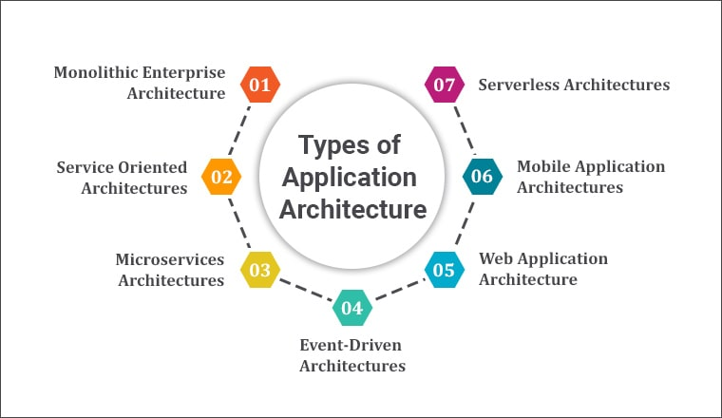
18
Notes:
Monolithic Architecture: In this traditional architecture, the entire application is built as a single unit. All components (user interface, business logic, and data access) are tightly coupled. While it's straightforward to develop and test, it can become complex and challenging to scale as the application grows.. Service-Oriented Architecture (SOA): SOA involves creating reusable services that can be accessed over a network. It promotes interoperability among different services, allowing them to communicate and share data. While similar to microservices, SOA often involves larger, more centralized services and might have a heavier reliance on standards like SOAP. Serverless Architecture: This model abstracts server management, allowing developers to focus on writing code without worrying about infrastructure. Code runs in stateless compute containers that automatically scale based on demand. It's cost-effective and scalable but might introduce limitations in certain use cases.

Slide 18
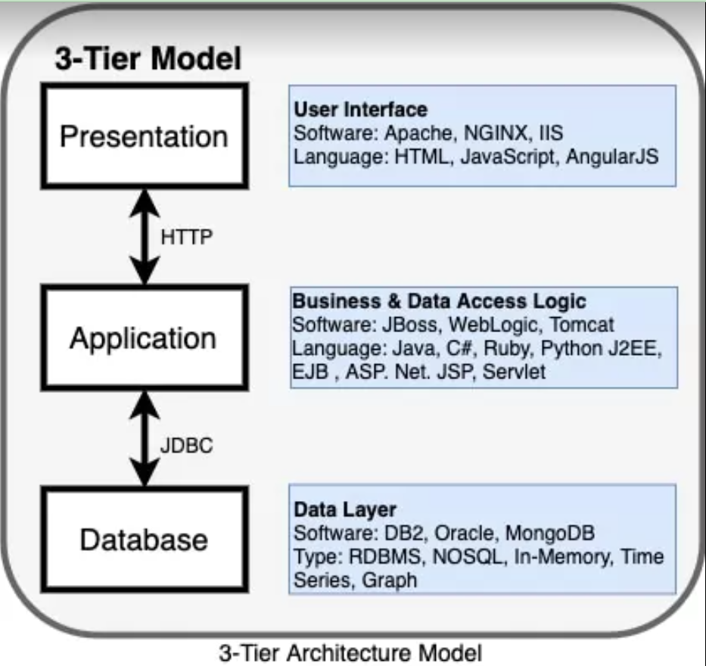
Traditional 3-tier application architecture
19
Notes:
We all know about the 3-tier application architecture—it is a client-server architecture with a typical structure consisting of the presentation layer, application layer, and database layer
It has a user interface, business/data access logic, and data access. Many enterprise applications were created using the simple 3-tier application architecture.

Slide 19

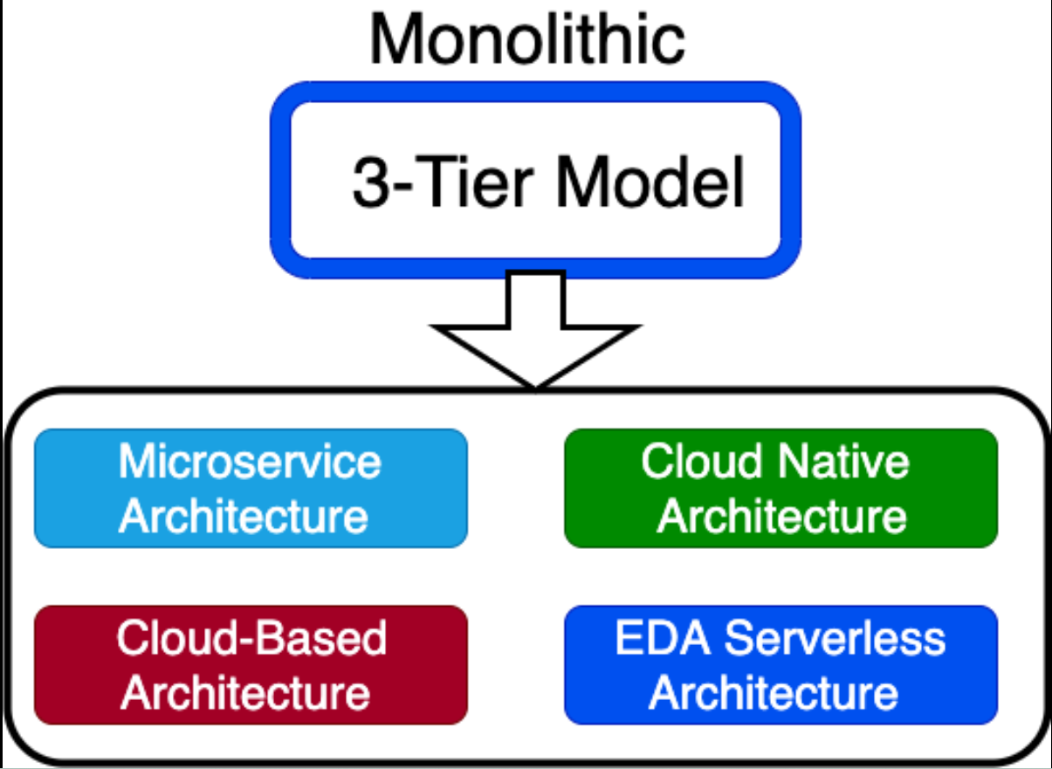
20
Notes:
Monolithic Architecture: In this traditional architecture, the entire application is built as a single unit. All components (user interface, business logic, and data access) are tightly coupled. While it's straightforward to develop and test, it can become complex and challenging to scale as the application grows..

Slide 20
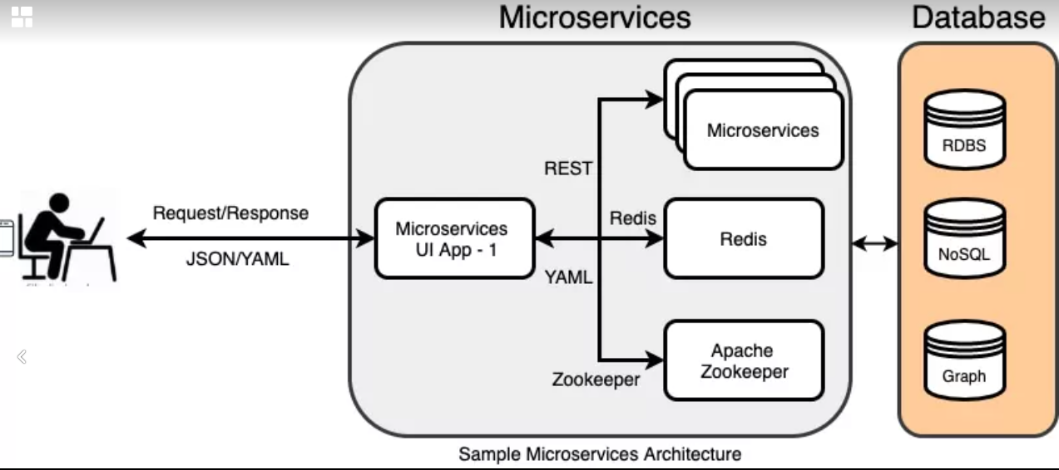
21
Notes:
Microservices Architecture: It decomposes the application into smaller, independent services that communicate through APIs. Each service focuses on a specific business capability and can be developed, deployed, and scaled independently. This architecture enhances flexibility, scalability, and allows for technology diversity but requires careful management of inter-service communication

Slide 21
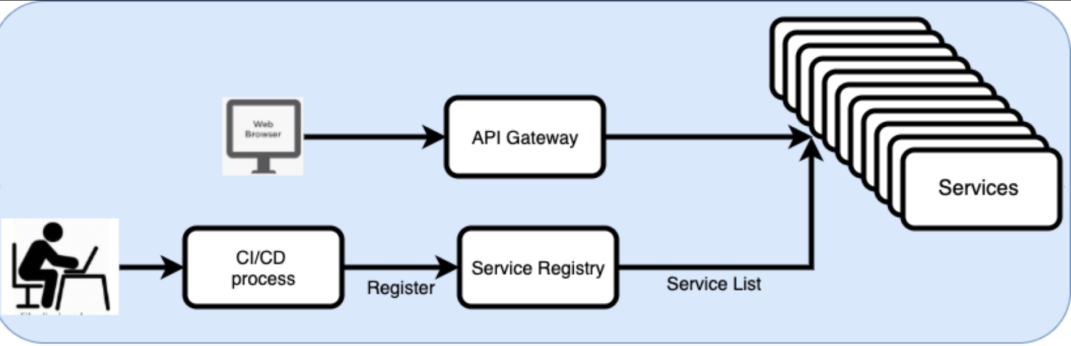
Cloud Native Architecture
22
Notes:
Cloud native architecture is an innovative software development approach that is specially designed to fully leverage the cloud computing model. It’s a combination of methodologies from cloud services, DevOps practices, and software development principles

Slide 22
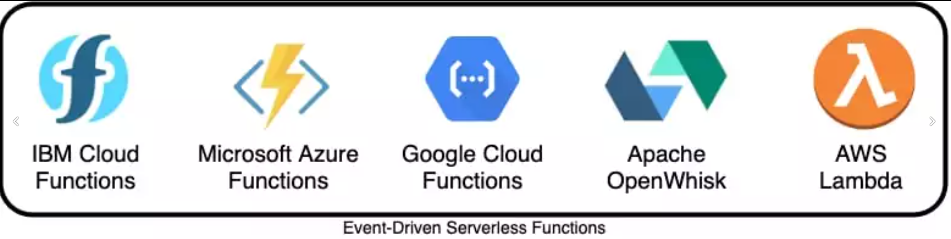
23
Notes:
Event-Driven Architecture (EDA): EDA focuses on events that trigger various actions within the system. Events are used for communication between different components, allowing for loose coupling and flexibility. This architecture is beneficial for real-time processing and scalability but requires careful handling of event reliability and consistency.

Slide 23
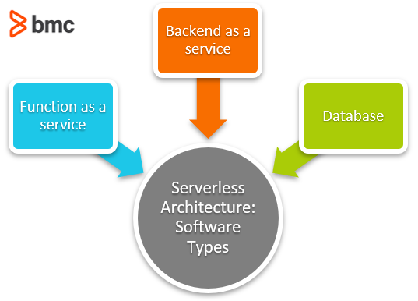
Types of serverless
Functions-as-a-Service (FaaS): Upload pieces of functionality to the cloud and let these pieces be executed independently.
Backend-as-a-Service (BaaS): Utilize services from a third party, such as application management, database management, and cloud storage.
Mobile-Backend-as-a-Service (MBaaS): Functions for mobile applications.
24

Slide 24
Challenges of Application Architecture.
05
25

Slide 25
Challenges of application architecture
Scalability: Handling growth without slowing down.
Security: Protecting data from breaches.
Maintainability: Keeping it easy to update and fix.
Interoperability: Making it work well with other systems.
Performance: Ensuring it runs fast and efficiently.
Adaptability: Being flexible for future changes.
Cost Management: Optimizing expenses effectively.
Testing and Debugging: Finding and fixing issues efficiently.
Documentation & Communication: Clearly explaining how it all works.
26

Slide 26



Our Team: Zero’s Splash
Md. Sakibul Islam
Id: B190305035
mdsakibulislam736@gmail.com
Asifuzzaman
Id: B190305023
asifuzzamanasif001@gmail.com
27

Slide 27
Thanks!
28

Slide 28
References
https://radixweb.com/blog/what-is-application-architecture
https://www.techtarget.com/searchapparchitecture/definition/application-architecture
https://cio-wiki.org/wiki/Application_Architecture
23

Slide 29
Any Question?
24

